Slide 1

Gobs Studio

Slide 2
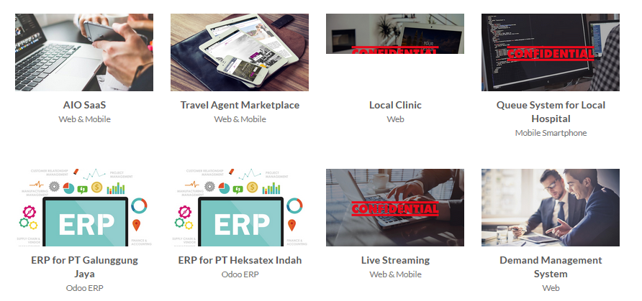
Portfolio

Slide 3
BeliRu.co.id
Yoga Nanda Saputra
Megawati Ristanti
Yosias Suparno
Benny Putra Halim

Slide 4
BeliRu.co.id
This is our Project, that’s call
BeliRu.co.id
This is a Web-Based Information System that serves the sales & purchases of Shop (Ruko). This system can be accessed throught Indonesia
This project is planned to be completed within 2 months with funds ranging from 90 million rupiah. In this project , we will use Scrum method to completed

Slide 5
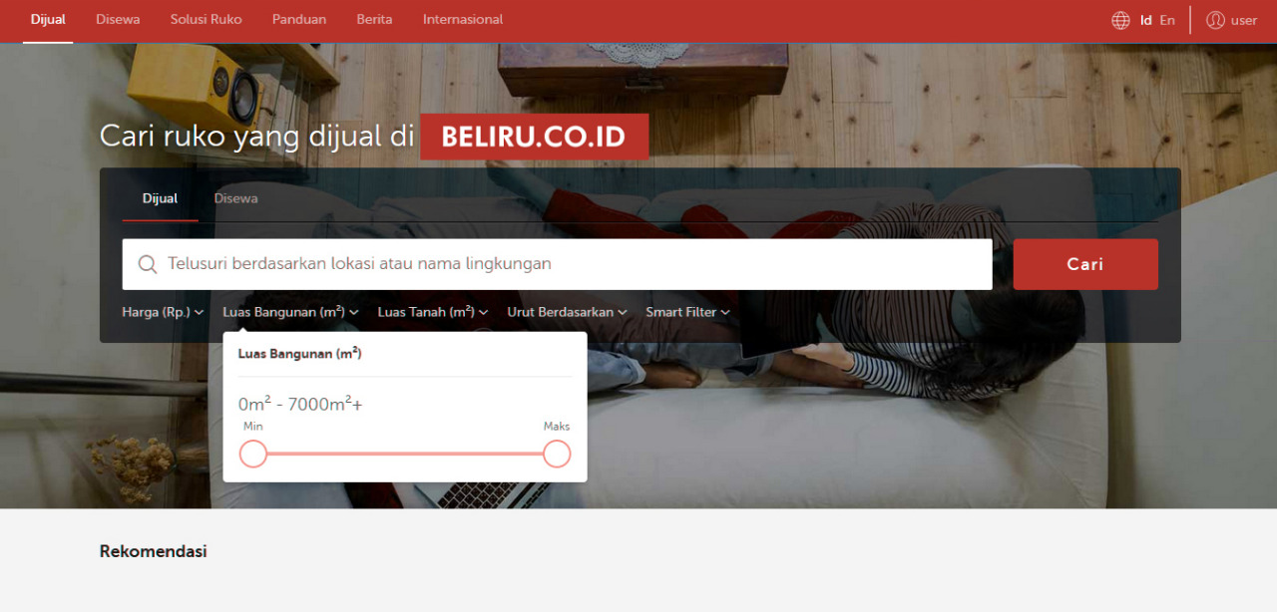
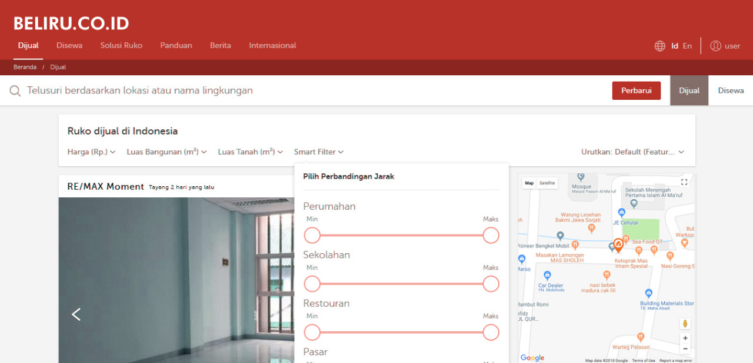
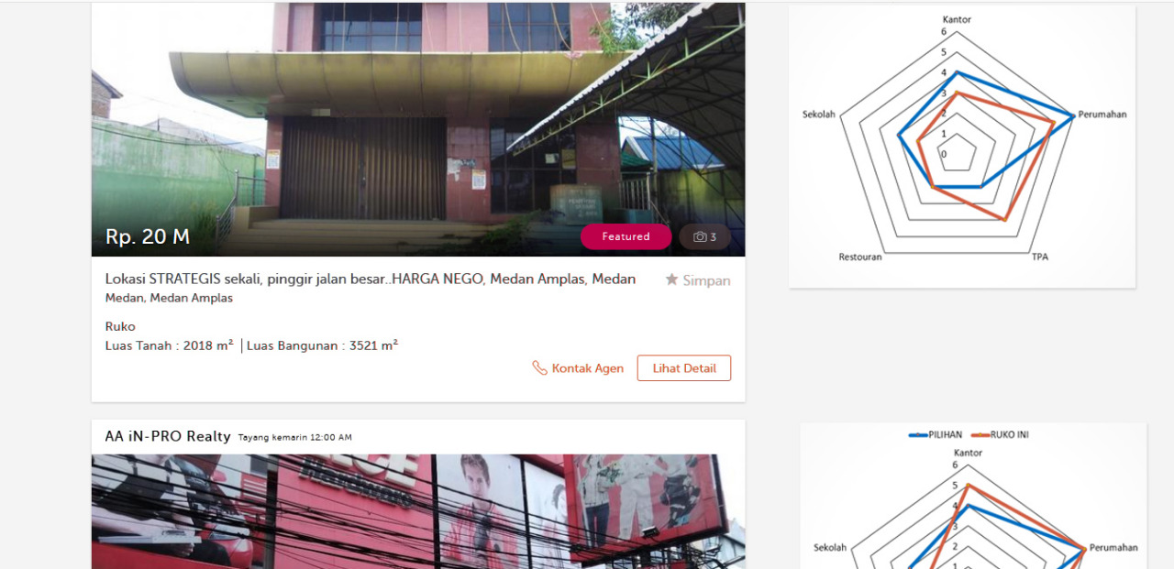
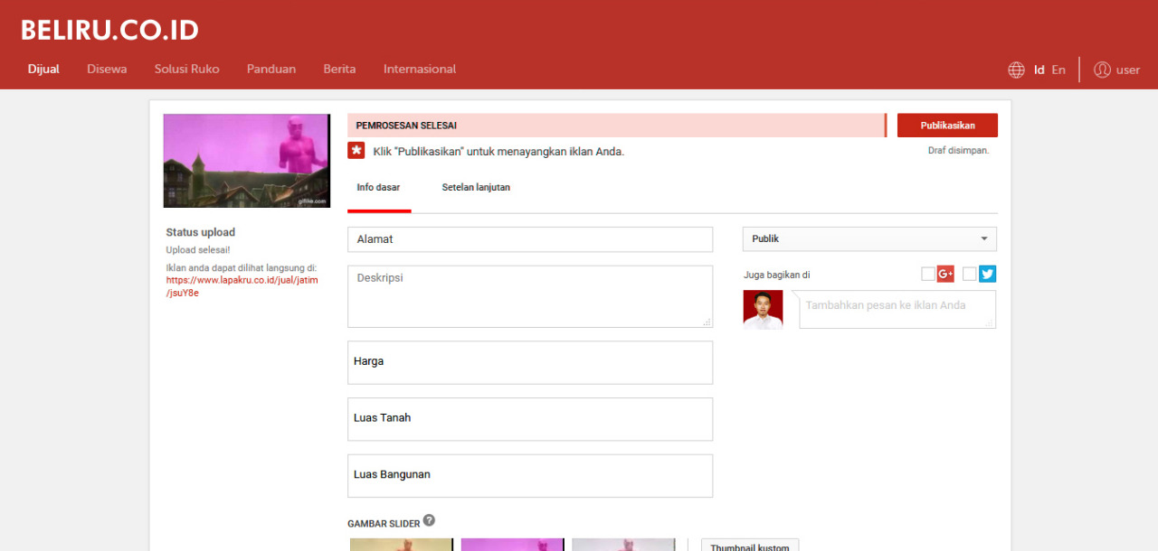
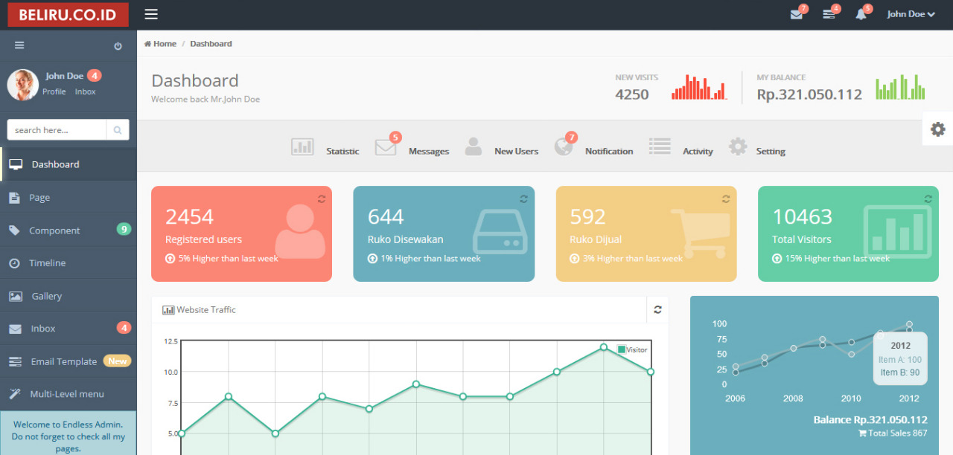
MOCKUP

Slide 6
Organization Chart
Yoga Nanda Saputra
Project Manager
Benny Putra Halim
Analyst
Yosias Suparno
Web Developer (Back-end)
Mega Ristanti
Web Designer & Quality Control

Slide 7
Project Duration
Timeframe
Project Resources
8 Week Development
Development in Malang City
Report & coordination can be done throught Teleconference or we come to your office
Roles | Man Days
Project Manager | 27
Analyst | 24
Tester | 10
Developer | 31
Designer | 11

Slide 8
Project Timeline
1– 14 June 2018 : Gathering Requirements
18 – 19 June 2018 : Project Plan
20 – 29 June 2018 : Design
2 – 11 July 2018 : Development
13 – 20 July 2018 : Testing
23 – 30 July 2018 : Publishing

Slide 9
Project Budget
No. | Cost | Total Cost
1 | Software Implementation Cost | Rp 59.563.636,36
2 | Overhead Cost | Rp 17.605.200,00
3 | Post Go Live Support (1 month) | Rp 4.336.363,64
TOTAL |  | Rp 81.505.200,00
GRAND TOTAL |  | Rp 89.655.720,00

Slide 10
Software Implementation Cost
Gathering Requirements
No. | Resource | Man | Day | Effort | Fixed Man Day | Fixed MD * Days
1 | Project Manager | 1 | 15 | 100% | Rp 561.818,18 | Rp 8.427.272,73
2 | System Analyst | 1 | 15 | 100% | Rp 545.454,55 | Rp 8.181.818,18
 |  |  |  |  | TOTAL | Rp 16.609.090,91
Development
No. | Resource | Man | Day | Effort | Fixed Man Day | Fixed MD * Days
1 | Project Manager | 1 | 25 | 100% | Rp 561.818,18 | Rp 14.045.454,55
2 | System Analyst | 1 | 24 | 100% | Rp 545.454,55 | Rp 13.090.909,09
3 | Web Designer | 1 | 9 | 100% | Rp 289.090,91 | Rp 2.601.818,18
4 | Web Developer | 1 | 22 | 100% | Rp 289.090,91 | Rp 6.360.000,00
5 | Tester | 1 | 9 | 100% | Rp 289.090,91 | Rp 2.601.818,18
 |  |  |  |  | TOTAL | Rp 38.700.000,00

Slide 11
Deployment (UAT & Training)
No. | Resource | Man | Day | Effort | Fixed Man Day | Fixed MD * Days
1 | Project Manager | 1 | 5 | 100% | Rp 561.818,18 | Rp 2.809.090,91
2 | Web Developer | 1 | 5 | 100% | Rp 289.090,91 | Rp 1.445.454,55
 |  |  |  |  | TOTAL | Rp 4.254.545,45
Maintenance
No. | Resource | Man | Day | Effort | Fixed Man Day | Fixed MD * Days
1 | Web Developer | 1 | 15 | 100% | Rp 289.090,91 | Rp 4.336.363,64
 |  |  |  |  | TOTAL | Rp 4.336.363,64

Slide 12
Overhead Cost
Gathering Requirements (1st Week)
UAT
User Training
Man | Days | Plane | PP Client - Hotel | Hotel Room | Hotel | Allowance | Total
2 | 5 | Rp 2.385.600,00 | Rp 150.000,00 | 1 | Rp 3.500.000,00 | Rp 1.500.000,00 | Rp 7.535.600,00
Man | Days | Plane | PP Client - Hotel | Hotel Room | Hotel | Allowance | Total
2 | 3 | Rp 2.385.600,00 | Rp 150.000,00 | 1 | Rp 2.100.000,00 | Rp 900.000,00 | Rp 5.535.600,00
Man | Days | Plane | PP Client - Hotel | Hotel Room | Hotel | Allowance | Total
2 | 2 | Rp 2.384.000,00 | Rp 150.000,00 | 1 | Rp 1.400.000,00 | Rp 600.000,00 | Rp 4.534.000,00

Slide 13
THANKS

